Slide 1
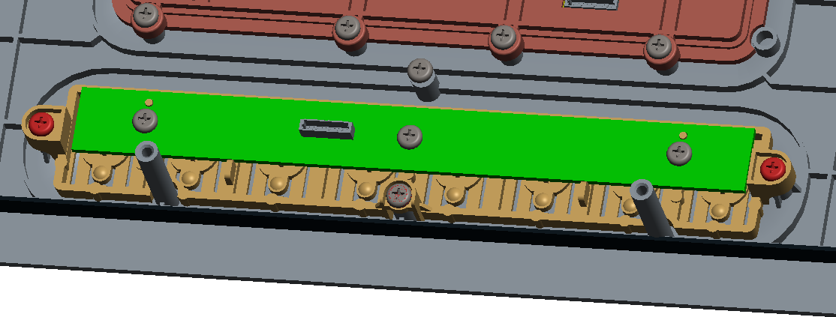
Found that on current mockup samples, the touch feeling was not the same on each button, one or two keys were worse than others.
(because mock-up samples on our hand are not many and need Inkel to look into this potential issue)
Pre-action if issues still existed after DVT :
may add more ribs from case top to support button part, to avoid case top and button part are designed as surface by surface matching.
The springs of button may be revised to be more elastic probably.
Button part

Slide 2
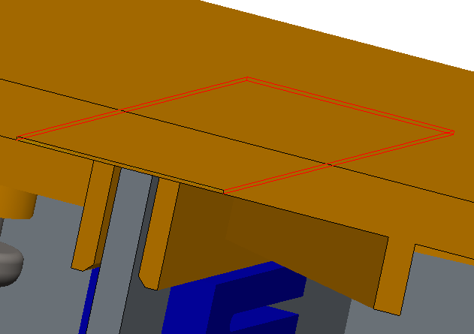
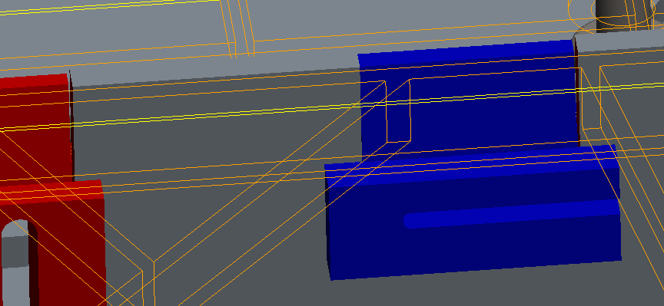
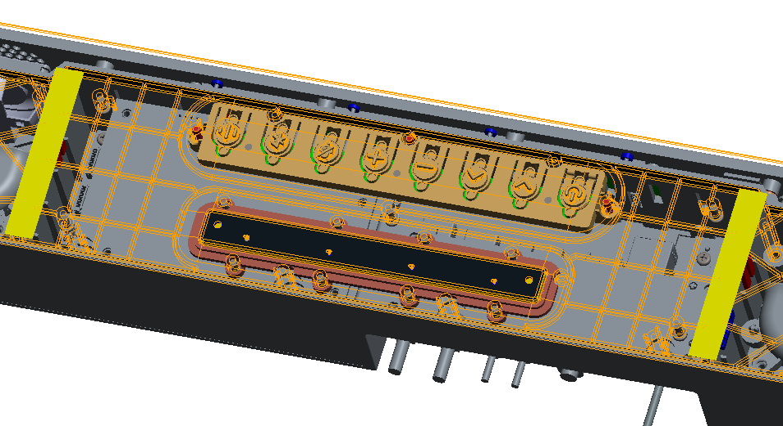
Pre-action if leakage still existed after DVT :
may thicken the foams to fill in the gap space.
Foam-1/foam-2(in yellow)
Gap between rubber and case

Slide 3
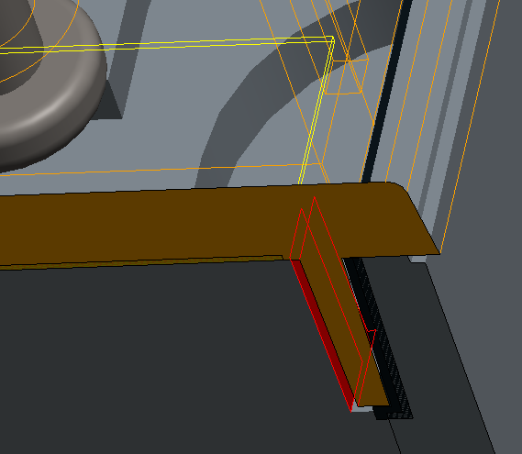
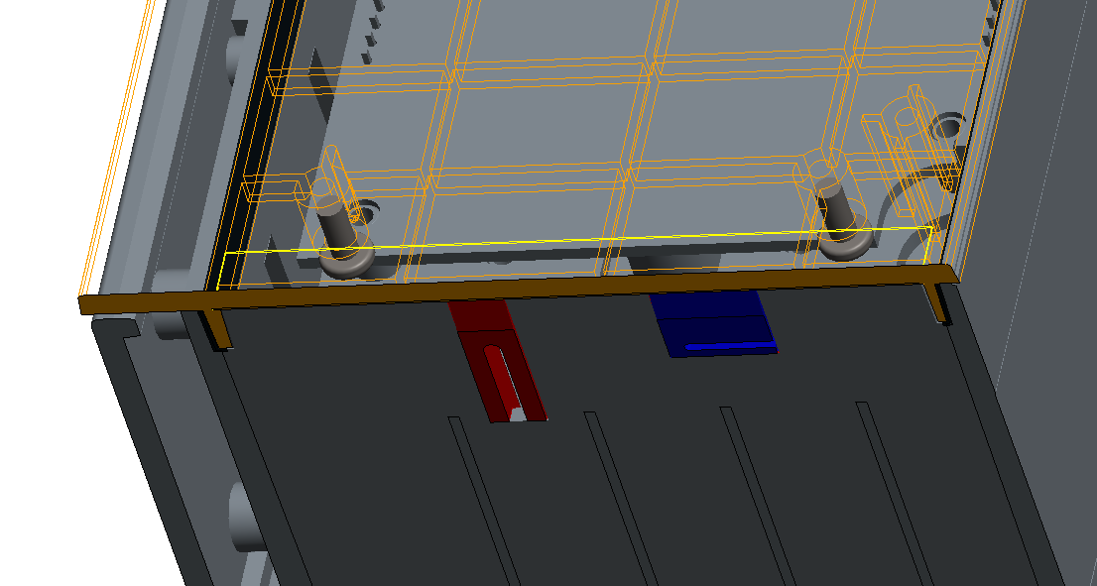
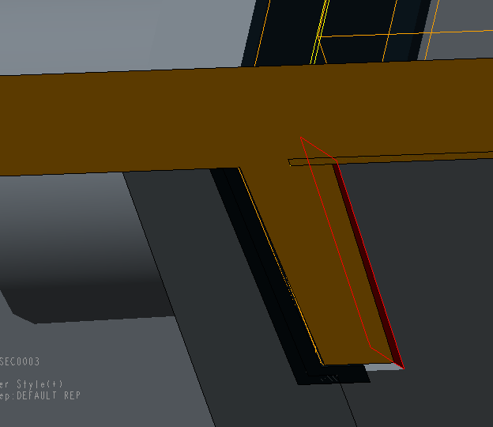
Pre-action if leakage still existed after DVT :
may extend the foams to fill in the gap space.
gaps

Slide 4
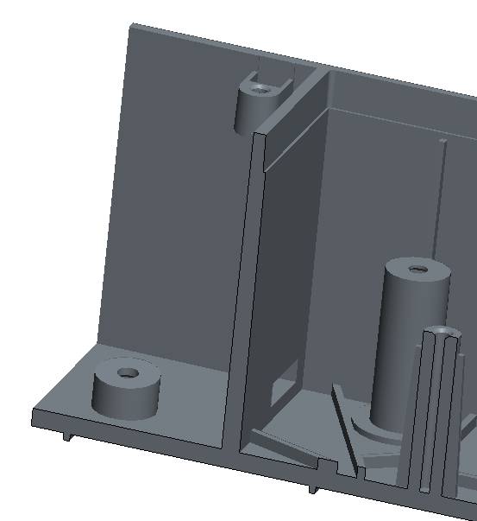
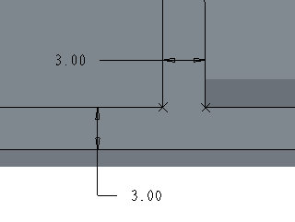
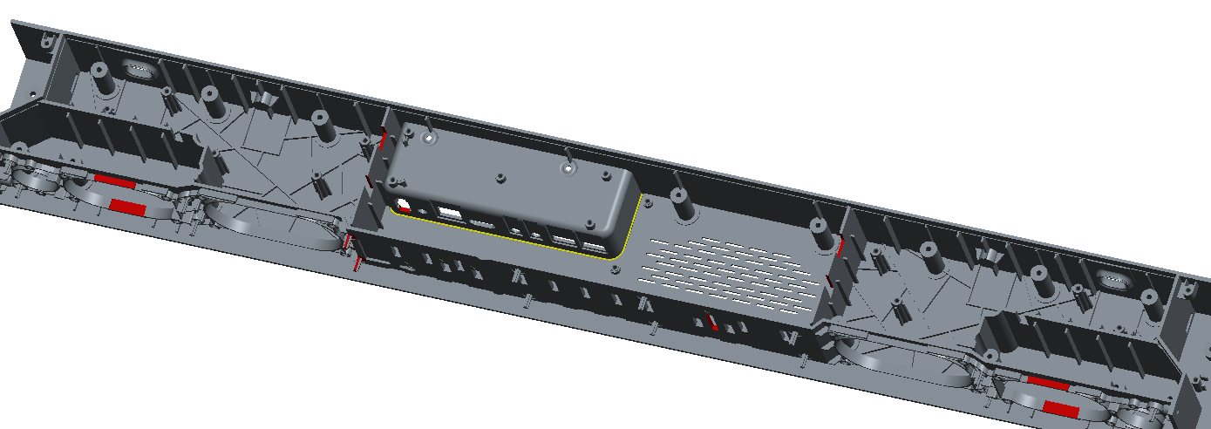
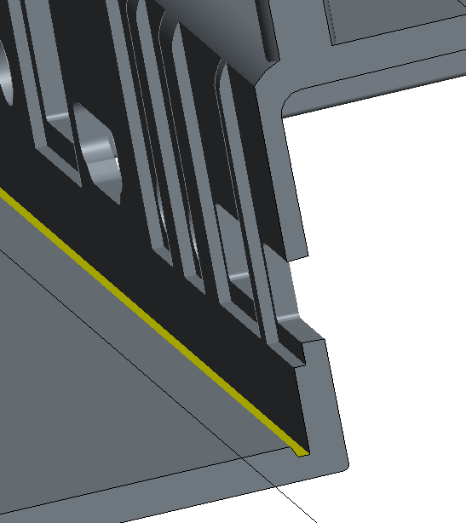
We can see the groove feature (A area) has been created to prevent molding defects on case bottom.
But silimar design features( likes B area )are still not optimized yet, has the tooling shop evaluated and confirmed that it is workable for molding as well?
B
B
A
Groove to prevent molding issues
B
A
B

Slide 5
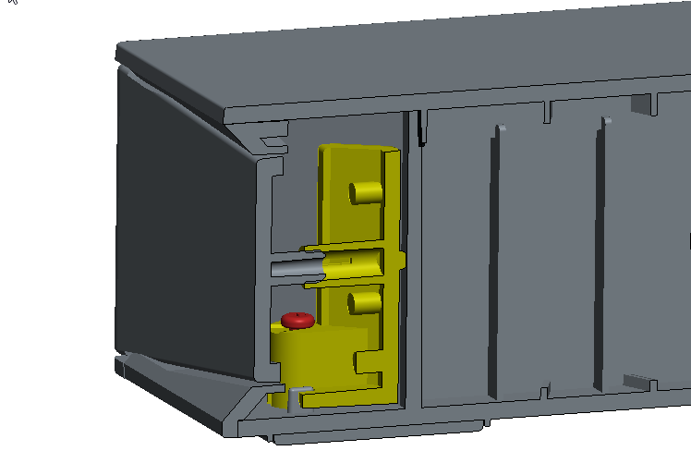
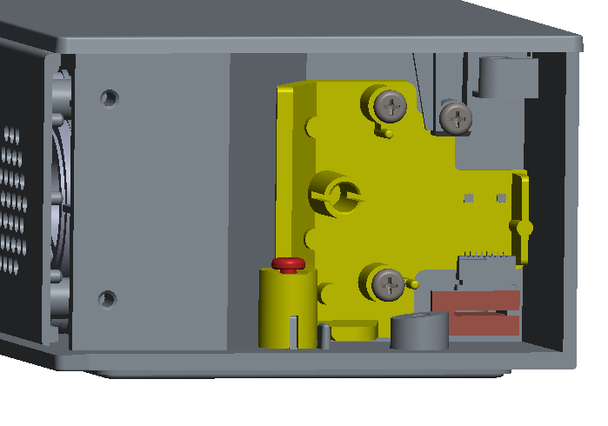
Pls evaluate if it is available to add ribs from case top, to limite the potential movement or shake on bracket-side-LED, there seems only one screw to fix this part.

Slide 6
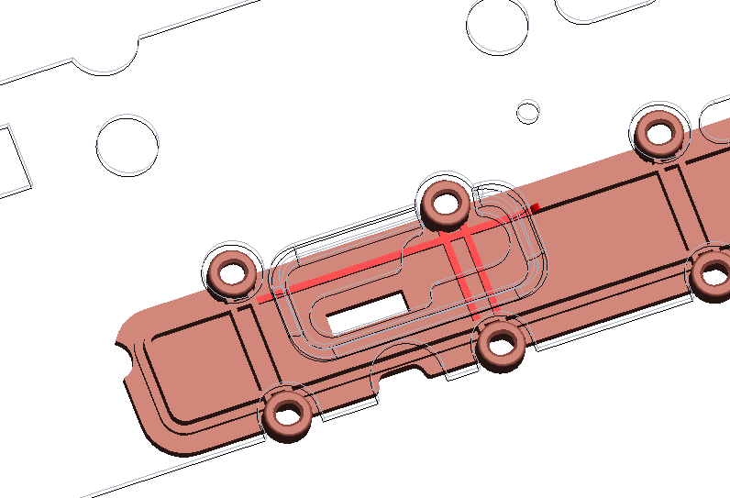
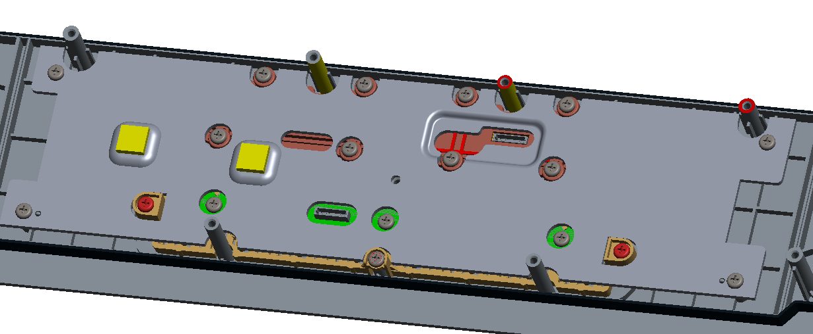
can we update the heatspreader_AMP_Top likes this? So that it is more easy to insert the cable connector.
Accordingly, the holder_mic needs to be make a cut out(in red color) to prevent interference.
Pls confirm if available?

Slide 7
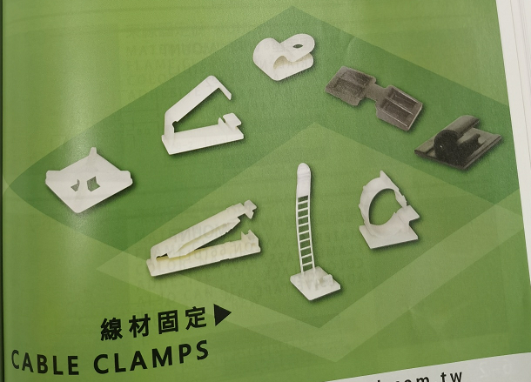
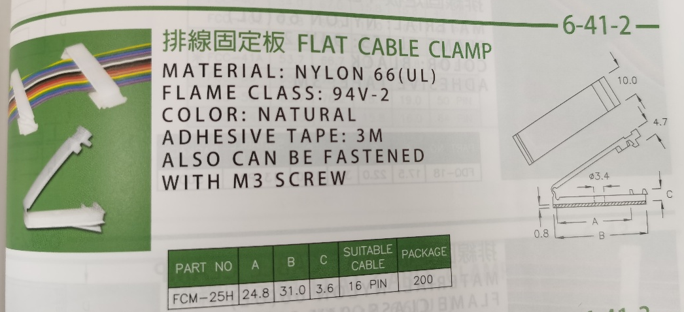
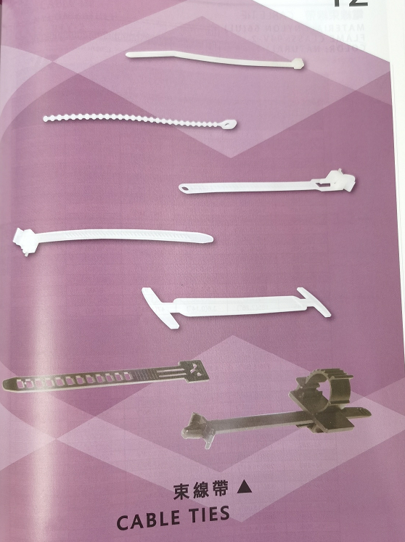
We need cable ties and clamp in next coming production. Any requirement for this from Inkel’s point of view?

